Slide 1

In the case the OM – packages fail to import
Daniel Mager /Daniel@magdata.de

Slide 2
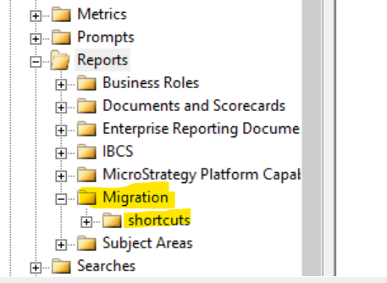
MSTR – Robotics devOps automatization using low coding strategies
Please build in the project where you want to create you migration package the following objects:
Within the Migration folder you‘ll create MTDI – Cubes
Within shorcuts you‘ll create shorcuts based on searches or change logs
You‘ll use the GUIDs of those folders in your Colab Notebooks

Slide 3
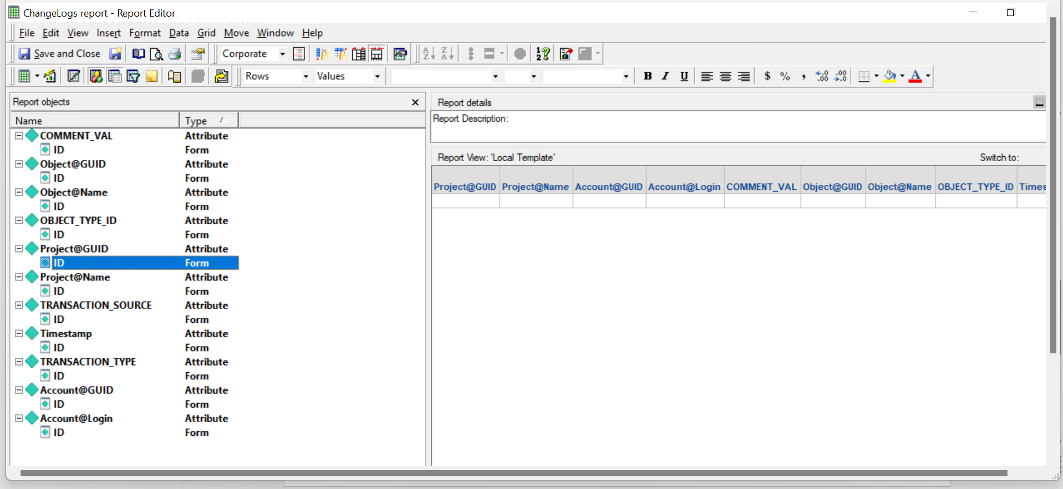
MSTR – Robotics devOps automatization using low coding strategies
Please build the following MD report, if you want to fetch the logs from there

Slide 4
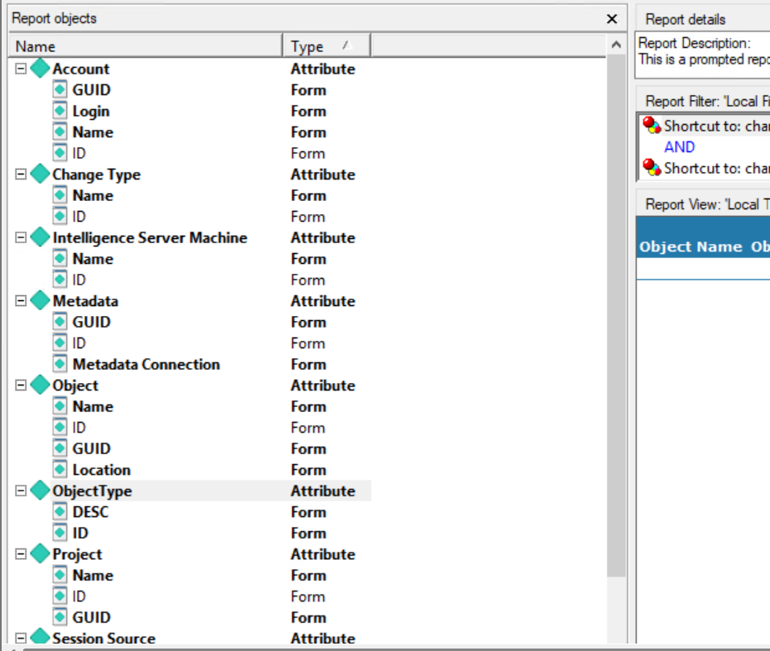
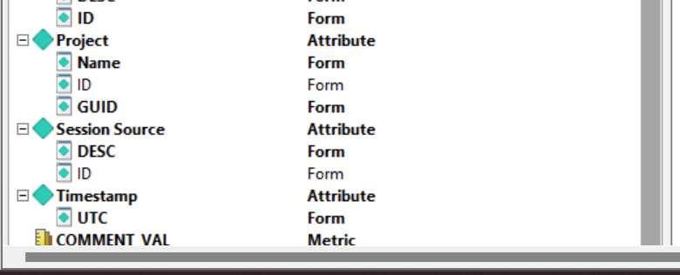
MSTR – Robotics devOps automatization using low coding strategies
Please build the following PA Report, if you want to fetch the logs from there

